Slide 1


Efficient Computing Techniques and Resources offered at CCSS

Slide 2
Types of Environments. Purpose for Each
Public Cloud Computing
Dedicated Public Cloud Computing. High Compute or RAM
Dedicated Private Computing. Higher Compute or RAM. Admin permissions
Regulated Research

Slide 3
Public Cloud Computing
Apply for access. Need approval from a Cornell faculty member
Sign in associated with Cornell netid
Available Software
500GB of free storage. Associated with college and faculty member. Projects
128GB RAM, 16 core
Cloud Computing Information
Documentation. Microsoft encourages application version over browser. Reason.
Signing out

Slide 4
Dedicated Public Cloud Computing
Public cloud is a shared computing resource. Public dedicated cloud computing is when researcher/group has access to all resources for themselves
128GB RAM, 16 core
Same applications and storage as Public cloud dedicated just for individual researcher or group.
Upon request. Meet with CCSS consultant Jacob Grippin to see if your situation needs dedicated computing
No admin permissions. Just like shared cloud. Similar login process

Slide 5
Dedicated Private Computing
RAM requirements more than 128GB, more CPU than 16 core if desired.
Install other applications not displayed in this list. Free applications, or you/your group purchase applications.
Meet with CCSS Consultant Jacob Grippin to determine proper resources for users’ research. If environment is proper fit for you/group.
Admin permissions to make any changes. CCSS staff to assist with maintenance and installation of software.
Connect to Cornell network through Cisco or connect while on campus.

Slide 6
Regulated Research Environment
Working with confidential/restricted data.
Data needs to be stored on secure environment.
Information
Staff can help you get setup on system. Where to store data. Meet with CCSS Regulated Research Staff member.
List of applications

Slide 7
Parallel Computing: R
Parallel, doParallel packages
makeCluster to set number of cores to run in parallel.

Slide 8
Parallel Computing: Stata
Parallel Package. Package documentation

Slide 9
Parallel Computing: Matlab
Parpool to set number of core, parfor to include in loop.
sample code

Slide 10
Other CCSS Resources
Programming/Coding Consultation, Data Consultation. For 1v1 or group trainings. Qualitative, Quantitative, Accessing and working with Data. (Python, R, Stata most popular)
CCSS Workshops. Recordings upon request. Email socialsciences@cornell.edu
Data Discovery and Replication

Slide 11
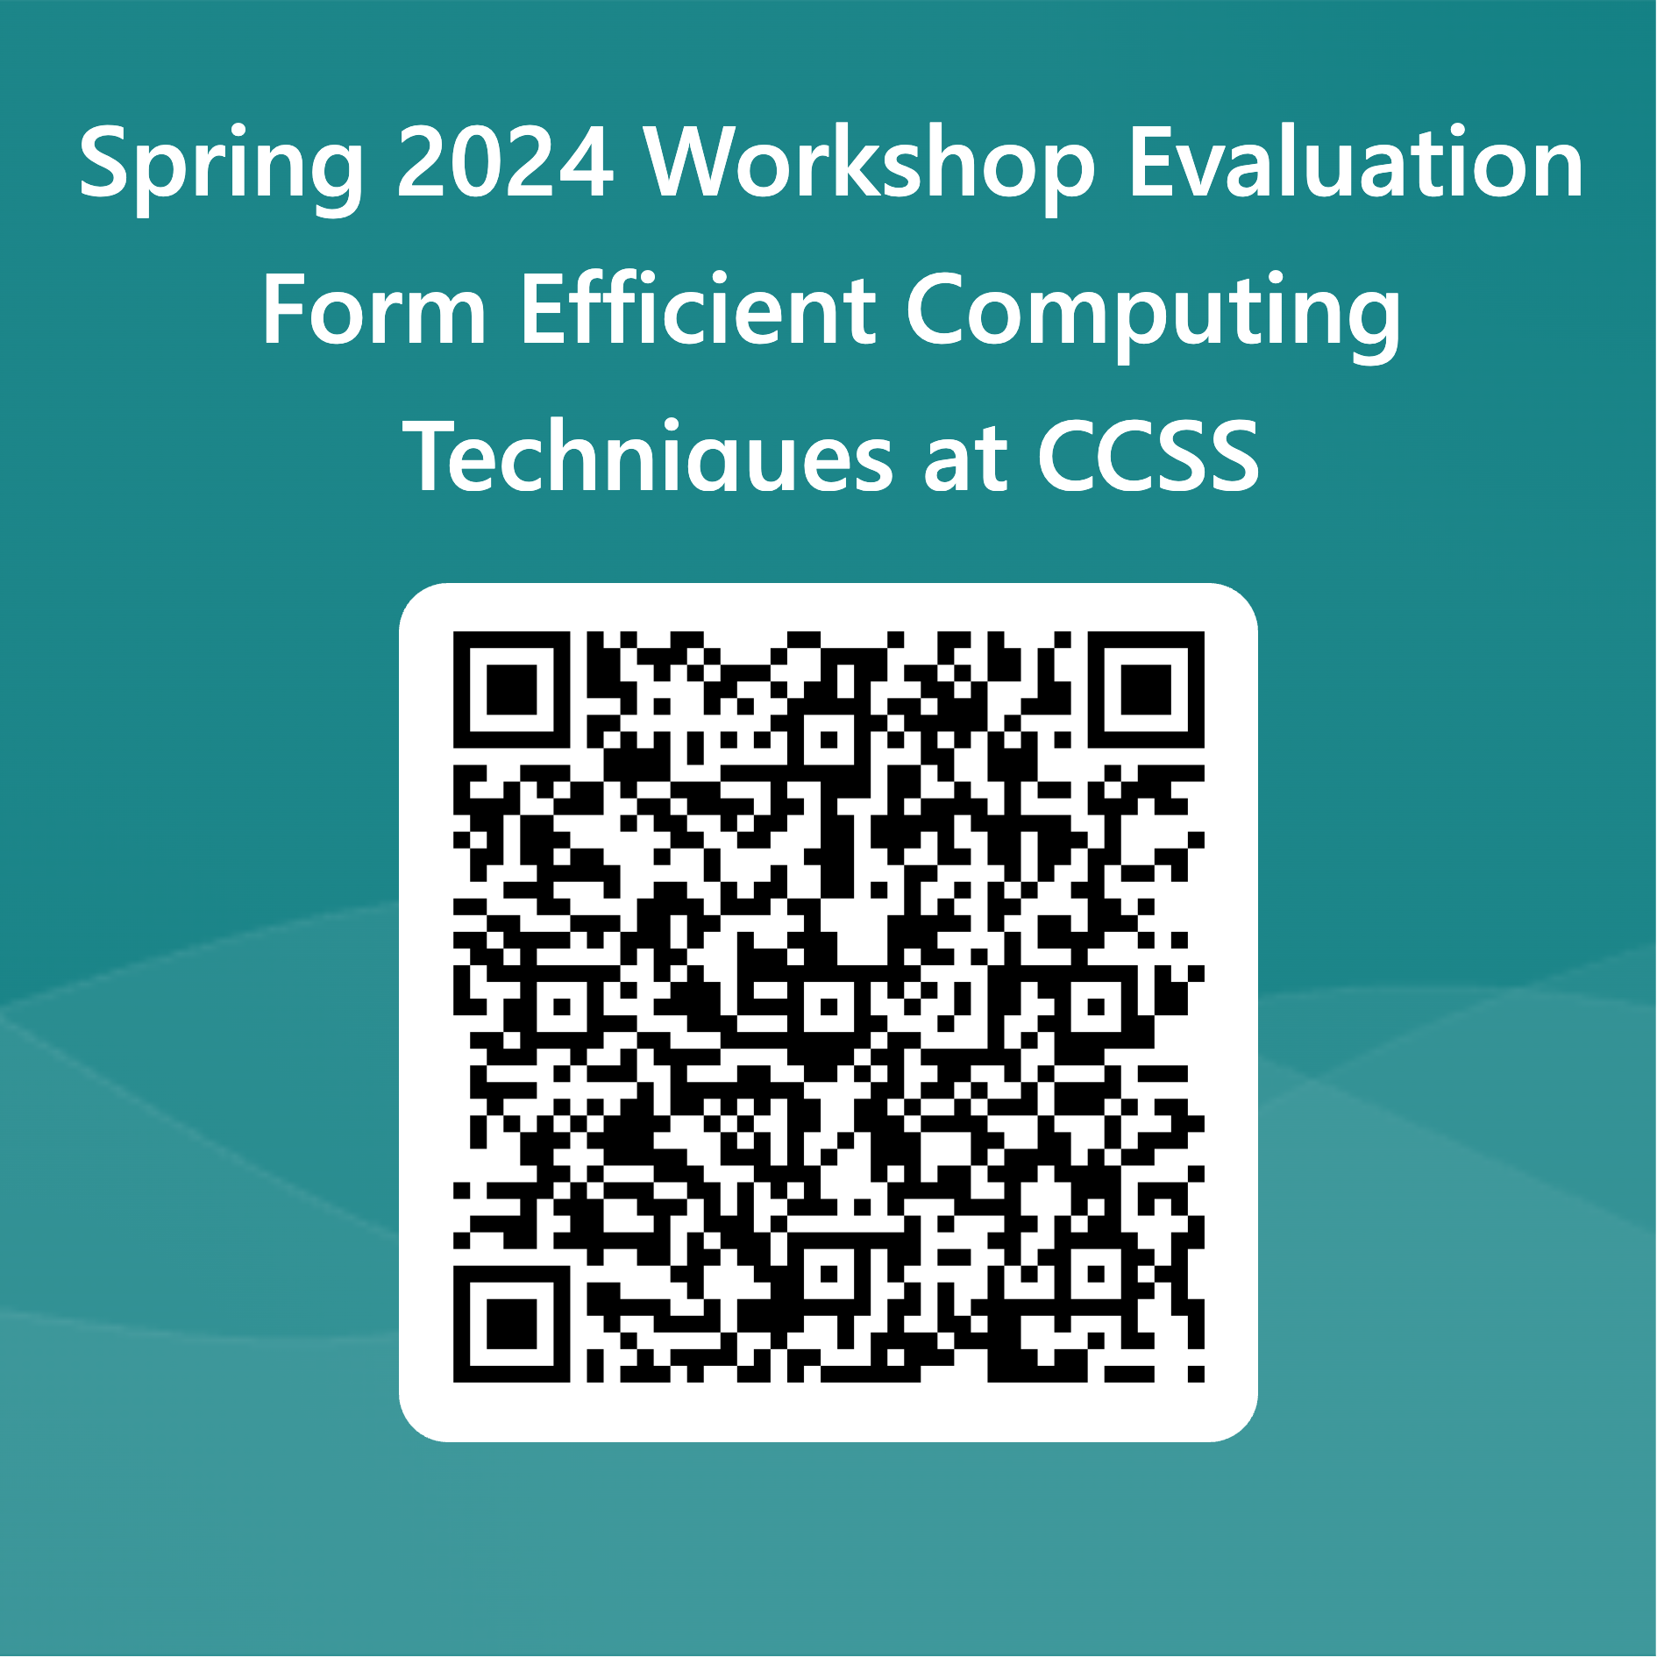
Evaluation Form

